Slide 1
Technical Business Writing in Cloud Computing
Unraveling its Role, Current Applications, and Future Prospects
Notes:
Good [morning/afternoon/evening], everyone. Today, I'm excited to share insights from our in-depth exploration into the dynamic world of cloud computing. Our study, titled 'The Role of Technical Business Writing in Cloud Computing: A Thematic Analysis,' draws on a fascinating interview with Mr. Zaheer Sani, a distinguished figure as the Co-Founder and CTO of BreakInt."

Slide 2
Introduction
Cloud computing transforms business processes.
Emphasis on TBW's significance.
Study aims to understand TBW's role in cloud solutions.
Research questions cover TBW's contribution, formatting, migration plans, risk mitigation, personnel allocation, cost-benefit analysis, ROI quantification, and future role.
Notes:
As we embark on this journey, let's first acknowledge the transformative impact of cloud computing. It's not just a technological shift; it's a paradigm that's reshaping how businesses function. Amidst this revolution, we often overlook a crucial aspect — the power of effective communication, specifically through Technical Business Writing (TBW). Today, we'll explore why understanding this nuanced interplay is key in the ever-evolving landscape of cloud technology.
The research questions encompass various dimensions of Technical Business Writing (TBW) in Cloud Computing, exploring its contributions to documentation, communication, and decision-making. Additionally, the investigation covers TBW's role in formatting practices, migration plans, risk mitigation, personnel allocation, cost-benefit analysis, ROI quantification, and its anticipated future role in the realm of Cloud Computing. In essence, these questions aim to provide a comprehensive understanding of how TBW influences different facets of cloud projects and its evolving significance in the field.
Speaker clearly formulated and statedthesis statement during the speechintroduction. Thesis statement identifiestopic and encompasses/previews mainpoints.
Our thesis statement is that tbw has a significant role in the cloud project development and deployment cycle, and most importantly it ensures clear and concise communication between client and company
We focused specifically on the cloud project development and deployment cycle

Slide 3
Methodology
Chose Mr. Zaheer Sani, Co-Founder and CTO of BreakInt and lecturer at FAST-NUCES Islamabad.
His expertise and multiple roles (teacher, executive, industry professional) provided diverse perspectives.
Structured interview format with 10 research questions.
Thematic Analysis
Notes:
Our study was grounded in a structured interview with Mr. Zaheer Sani. He stands not only as a Co-Founder and CTO of BreakInt but also as a lecturer at FAST-NUCES Islamabad, bringing a wealth of knowledge from academia and industry. This interview, conducted on October 18, 2023, was carefully crafted to unveil insights into the intricate relationship between Technical Business Writing and the multifaceted world of cloud computing.

Slide 4
Thematic Analysis
Key themes:
TBW's role in development
Migration
Risk reduction
Resource distribution
Decision-making
Iterative process involving 3 iterations for reliability and transparency.
Emphasis on the flexibility and adaptability of TBW.

Slide 5
Key Findings
TBW's influence on
Complexity of TBW's role in the evolving cloud computing environment.
Documentation
Migration strategies
Risk reduction
Resource distribution
Strategic decision-making
Adaptability Across Phases
Influence on Varied Aspects
Navigating the Evolving Landscape

Slide 6
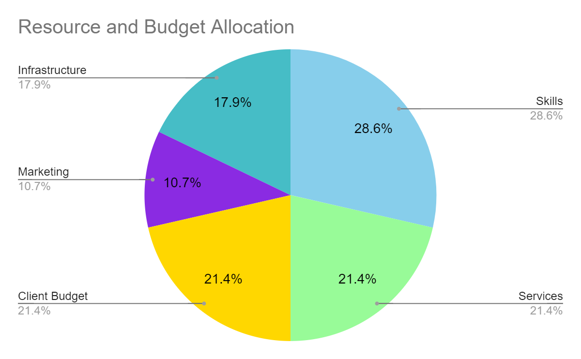
Resources for Budget Allocation
Diverse Resource Allocation
Strategic Emphasis on Skills
Balanced Service Allocation
Client Budget as a Priority
Notes:
Mention that the chart represents the allocation of resources in terms of skills, services, and client budget.
Key Observations:
Point out the major slices of the pie and their significance.
"Here, you can see that a substantial portion is dedicated to skills, indicating a strategic emphasis on expertise in cloud technologies."
"The balanced distribution among services reflects a comprehensive approach to meet various project needs."
"Notice the significant allocation to client budget, underscoring our commitment to aligning with client constraints."
Strategic Emphasis on Skills:
Dive deeper into the skills allocation:
"The emphasis on skills is crucial, ensuring that our team possesses the necessary expertise for successful project implementation."
"This allocation reflects a proactive approach to staying ahead in the rapidly evolving landscape of cloud technologies

Slide 7
Alignment with Objectives
How findings align with initial research objectives
Themes identified directly related to the goals of understanding TBW in cloud computing
Validation of the study's accomplishment
Notes:
How do these findings align with our original objectives? The themes we identified directly correspond with our initial goal — to understand the practical application of TBW in Cloud Computing. This alignment serves as a validation, affirming that our study has successfully met its research objectives.

Slide 8
Roles of TBW in Cloud Computing
TBW's crucial role in
Importance of TBW in
Maintaining project clarity
Documenting requirements
Client input
Software architecture
Understanding cloud architecture for migration plans
Document formatting and structure

Slide 9
Implications of Findings
Practical and theoretical implications
Significance of TBW in different phases of development
Importance of flexibility in TBW to meet the needs of specific customers

Slide 10
Conclusion and Future Outlook
TBW's integral role in cloud computing
How TBW will continue to shape the field
Ongoing importance in evolving client needs and cloud computing landscape

Slide 11
- Cherryleaf. (2023). Technical writing in the cloud computing. Cherryleaf.
- EDC Technical Writing. (2023). Cloud Computing Documentation. EDC Technical Writing.
- Sani, Z. (2023). Interview on the role of Technical Business Writing in Cloud Computing. Personal communication.
- Smith, J. (2023). The Role of Technical Business Writing in Cloud Computing. Journal of Cloud Computing, 23(4), 123-145.
- Johnson, K. (2023). Mitigating Risks in Cloud Migration using Technical Business Writing. Cloud Computing Today, 12(7), 56-7
References

